Slide 1

Phases of clinical trial

Slide 2

Drug development
Logical stepwise procedure in which
information from early studies is used to
support and plan later larger, more definitive studies
What is clinical trial ??
“A systematic study of pharmaceutical products on human subjects (whether patients or non patients volunteers) in order or verify the clinical, pharmacological (including pharmacodynamics and pharmacokinetics) and or adverse effects, with the object of determining their safety and efficacy”
G.S.R 32(E),dated 20th January 2005 – The Drugs and Cosmetics Act (IInd Amendment) Rules,2015
Notes:
If some one asks you to name greatest medical invention of 20th century polio, peniciilin, first anticancer drug, clilincal trial is medical invention that has contributed to nearly all life saving drug we know today organ transplant ,treat diabetes ,added 20 years for AIDS patient, prolongs the life of million cancer pateints

Slide 3
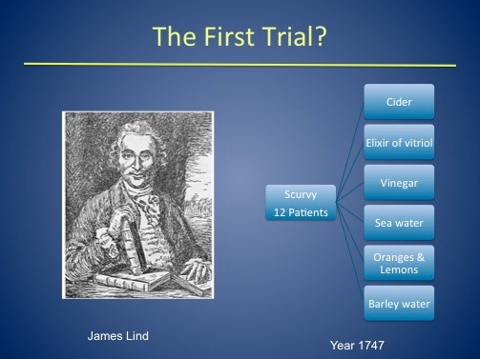

First randomised clinical trial =
Bradford Hill-study of streptomycin in pulmonary tuberculosis
Clinical Trial day: 20th May
Notes:
In 1754 James lind did first documented clinical trial on 20th May which is celebrated every year to give tribute for the day.

Slide 4
Why Are Clinical Trials Important?
Does the new treatment work in humans?
Is the new treatment safe?
Clinical trials,
Answer critical research questions
Find better treatments and ways to prevent disease
Translate results of basic scientific research into better ways to prevent, diagnose, or treat disease.
Notes:
Clinical trials answer 2 important questions..
Does the new treatment work in humans? If it does how well it works.
Is the new treatment safe? This must be answered while realizing that no treatment or procedure – even one already in common use – is entirely without risk. But do the benefits of the new treatment outweigh the possible risks?

Slide 5
Phases of clinical trial
Early Phase
Late Phase
Post marketing
IND
Phase I
Phase II
Phase III
Phase IV
NDA
Human Pharmacology
Therapeutics exploratory
Therapeutic confirmatory
Therapeutic uses
Compound success rates by stage:
5,000 to 10,000 250 enter pre- 5 Enter clinical 1 FDA
screened clinical testing testing approval
Notes:
IND: Investigational new drug
NDA: New drug application

Slide 6
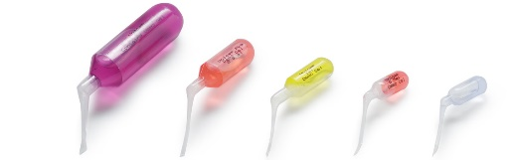
Phase O (Micro-dosing studies)
New viable tool in drug development toolbox
By definition, EMEA & FDA –
“Use of 100 mcg of candidate drug or less than 1/100th of the pharmacological dose determined from the animal models and in vitro systems using the test substance”
FDA further adds – “a maximum micro dose of <30 nanomoles of protein product”
Small sample size of 10 -15 subjects is required
Notes:
EMEA: European medical agency

Slide 7
Why conduct micro dose studies ??
To obtain information on human pharmacokinetics as early as possible.
Compare ADME parameters for several drug candidates where animal data may be conflicting
Helps in selecting the first dose for a Phase I study
Validate animal model for pharmacology and toxicology
Pharmacoeconomics – Cost benefit analysis
Goal of Phase 0 studies
To assess whether the mechanism of action defined in pre clinical studies is achieved or not
Define specific biomarkers or targets in human studies
Determine special methods to assess the pharmacokinetics of the drug
Develop novel models to evaluate the pharmacodynamics
Define human PK/PD data prior to phase I

Slide 8
Advantages of micro dosing
Requires minute quantities of drug – not intended to produce any pharmacological effect; risk of adverse events less
Decreases time of drug development decreases cost significantly
Reduces animal testing
Helps patients and industry with earlier availability of test drugs
Limitations of micro dosing
Insufficient information on body’s reaction to micro dose and pharmacological dose
Micro dosing may not be predict kinetic parameters accurately for drugs showing non-linear kinetics
Metabolism and stability of compounds
Limited specificity
Notes:
Saves time – Advance lead candidates to clinical development in months and not years
Saves money – Significantly reduced IND submission and cost

Slide 9

Phase 1 (Human Pharmacology studies)
“First in man studies”
Done in small group of 20 -80 healthy volunteers
Includes trials designed to assess the safety, tolerability, pharmacokinetics and pharmacodynamics of a drug.
Some of the Phase I trials include,
- Single Ascending dose studies
- Multiple Ascending dose studies
- Pharmacogenomics studies (PGx) (study of drug exposure and/or response as related to variations in DNA and RNA characteristics. interindividual differences)
- ADME studies
Notes:
Pharmacogenomics (PGx) refers broadly to the study of drug exposure and/or response as related to variations in DNA and RNA characteristics. PGx studies can contribute to a greater understanding of interindividual differences in the efficacy and safety of investigational drugs
BA/BE: Bioavailabilty and bioequivalence studies

Slide 10
Phase 1 studies
Single Ascending dose studies | Multiple Ascending dose
Small group of subjects given single dose of drug and observed for a period of time. If Pk data is in line with predicted safe values, then dose is increased in a new group of subjects Continued till maximum tolerated dose (MTD) is defined. | A group of subjects receives multiple low doses of the drug Samples (of blood and other body fluids) collected at various time points and analysed Gives better understanding of pharmacokinetics and pharmacodynamics of the drug
“Schedule of drug administration in Phase I is determined from the preclinical testing”

Slide 11
Phase 1 studies
ADME studies
Objectives:
To assess the absorption, distribution, routes and rates of excretion
To assess the metabolite profile and metabolite identification.
Pharmacogenomics study
Broadly refers to the study of drug exposure and/or response as related to variations in DNA and RNA characteristics and ,
Contribute to a greater understanding of inter-individual differences in the efficacy and safety of investigational drugs
Notes:
Pharmacogenomics: study of genomic influence on drug response.

Slide 12

Information obtained from Phase I studies
Maximum tolerated dose
Nature of adverse reactions that can be expected
Preliminary characterization of the drug
Accumulation of parent drug/ metabolites
Bioavailability in presence of food
Drug - drug interaction ( mostly parallel to phase II)

Slide 13
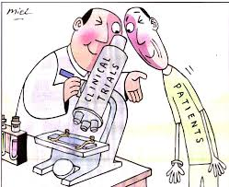
Phase I/II (Phase I in patients)
Test drug is too toxic to be tested in healthy volunteers
E.g anticancer drugs, HIV
Therapeutic range/ratio is too narrow to test
(e.g. Antiarrhythmic)
Dose in patient > Normal Volunteers can tolerate
(e.g. Neuroleptics)

Slide 14
Phase II
Phase IIa (Therapeutic exploratory studies)
Phase IIb – Dose range finding

Slide 15
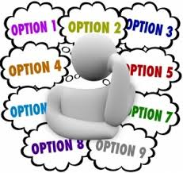
Phase IIa (Therapeutic exploratory studies)
Objectives:
Study therapeutic effect.
Confirm the hypothesis conceptualised
Features:
Treatment against disorder.
Homogenous population.
Strict inclusion and exclusion criteria.
Placebos and fixed treatment regimens
One or more than one dose tested
Few specialised clinical trial sites.
Long washout” period is required between treatments

Slide 16
Phase IIa studies
Sample size: 50 – 500 subjects
Efficacy Targets:
Clinical parameters: Symptoms and sign of disease
Laboratory tests: measure or study disease
Biomarkers: include biochemical markers for disease prognosis
PK and Population PK analysis.
Endpoints:
Clinical endpoint (preferred): Primary outcome are usually hard” and simple outcome
Surrogate (Duration for visible clinical effect is long): In multiple sclerosis No of gadolinium enhanced lesion at 6 months on MRI rather clinical exacerbation at 2 years.
Notes:
Gadolinium, also called "contrast," is a large, chemical compound that is injected into a person's vein during an MRI scan by a technician.
Gadolinium normally cannot pass from the bloodstream into the brain or spinal cord due to a layer of protection in a person's body called the blood-brain barrier. But during active inflammation within the brain or spinal cord, as during an MS relapse, the blood-brain barrier is disrupted, allowing gadolinium to pass through.
Gadolinium can then enter the brain or spinal cord and leak into an MS lesion, lighting it up and creating a highlighted spot on an MRI.

Slide 17

Information obtained from Phase IIa studies
Proves primary hypothesis
Efficacy
Effect Size
Adverse events (ADR of special interest)
Biomarker profiling

Slide 18
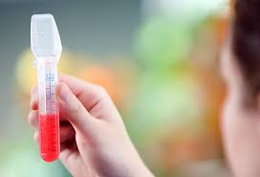
Phase IIb – Dose range finding
Objectives:
Determine optimal dose-response range
Features:
Test different doses and find optimal dose
Patient population defined
Placebo/Active controlled criteria
Tight inclusion and exclusion criteria
Multi-centre /Multinational trial

Slide 19
Phase IIb – Dose range finding
Sample size: 300 – 400 subjects
Efficacy Targets
Clinical parameters
Laboratory tests (centralized)
Biomarkers: (As per POC studies)
PK and Population PK
Endpoints
Clinical Endpoint (preferred)
Surrogate (not preferred)
Notes:
Surrogate ( not preferred as this will not give definitive answer)

Slide 20
Information obtained from Phase IIb studies
Dose-response
Frequency
Additional ADR
Identifying confounding factors
Type of patients more responsive to treatment.

Slide 21
Phase III
Phase IIIa : Confirmatory trials
Phase IIIb : Further explore dose-response relationship

Slide 22


Phase IIIa (Confirmatory trials)
Objectives:
To confirm safety and effectiveness of the drug
Basis for marketing approval (NDA application)
Features:
Active controlled studies
Conducted in patients in whom the drug will be eventually intended. Eg. Mild Asthmatics, Moderate and severe Diarrhoea
Inclusion and exclusion criteria relatively relaxed
Different dosages and combinations with other drugs
Different patient population
Multicentre/ Multinational trial
Also conducted in special group patients Eg Renal failure

Slide 23
Phase IIIa – Confirmatory trials
Sample size:
Several hundred to around 3000 patients
Efficacy Targets:
Clinical parameters
Laboratory tests
Diagnostic test
Endpoints:
Clinical endpoint

Slide 24
Information obtained from Phase IIIa studies
Definitive proof of efficacy
Additional safety data in large patients
Adverse effects with longer duration of treatment
Information for package insert and labelling of medicine.

Slide 25
Phase IIIb studies
Objectives:
Further explore dose-response relationship in different stages of the disease and in combination with another drug
Features:
Clinical trial after regulatory submission of an NDA but prior to approval and launch
Supplement earlier trials, complete earlier trials, directs towards new trials or phase IV evaluations
Notes:
Objectives Further explore dose-response relationship
Eg drug developed for severe diarrhea can be further used for mild and moderate

Slide 26

Post marketing Studies
Types:
Phase IV studies
Post marketing Surveillance (PMS)
Objectives:
Regulators gather additional information about a products safety efficacy, or optimal use.
Agreed with regulators at the time of approval of drug.

Slide 27
Phase IV studies
Features
Real life scenario
Inclusion/exclusion criteria are not stringent, wider patient population.
Ongoing technical support of a drug
Competitive reason of finding new market for drug.
Interaction with other drug if not tested earlier
Special population groups such as pregnant women
Study long term side effect

Slide 28
Post marketing Surveillance
Features:
Part of pharmacovigilance plan. (Risk Management Plan-RMP)
Rare adverse effects Eg. Immunogenicity.
Long Term adverse effects on larger population for longer period.
Monitor safety by
Spontaneous reporting databases
Prescription event monitoring
Electronic health records
Patient registries and records
Data mining process to highlight potential safety concerns.
Surveillance minimises harmful consequences and maximise optimal use of drug.

Slide 29
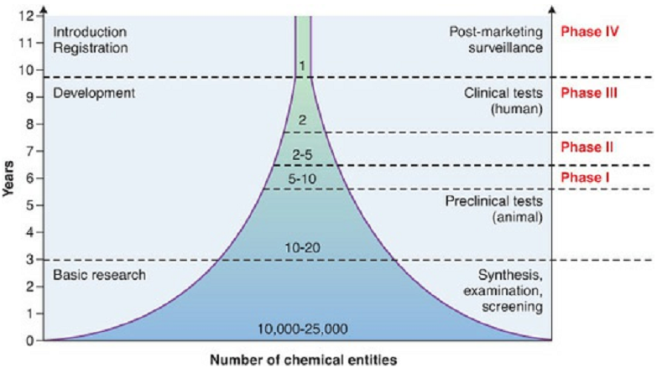

Slide 30
Phase I First in Human | Phase II First in Patient | Phase III Multi-Site Trial | Phase IV Post Marketing Surveillance
10-100 participants | 50-500 participants | A few hundred thousand to a few thousand participants | Many thousands of participants
Usually healthy volunteers; occasionally patients with advanced or rare disease. | Patient-subject receiving experimental drug | Patient-subject receiving experimental drug | Patients in treatment with approved drug
Open Label | Randomized & controlled (can be placebo-controlled):may be blinded | Randomized and controlled (can be placebo-controlled; may be blinded | Open label
Safety and tolerability | Efficacy and dose ranging | Confirm efficacy in larger population | Adverse events compianlce, drug-drug interactions
Months to 1 year | 1-2 years | 3-5 years | No fixed duration
U.S. $10million | U.S. $20million | U.S. $50-100 million
Success rate: 50% | Success rate: 30% | Success rate: 25-50%
Human Pharmacology | Therapeutic Exploratory | Therapeutic Confirmatory | Therapeutic Use

Slide 31
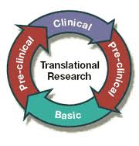
Phase V (Translational research)
Promises:
Avoid late phase surprises, More predictive models.
Navigates regulatory landscape-choosing valid tests and approaches.
Validation of new Biomarkers and Predictors.
Improving signal detection, safety assessment hence extrapolation of preclinical data to clinics.

Slide 32

Clinical Trials In Special Population
Pregnant and Nursing Women
Children
Geriatric patients
Renal dysfunction
Hepatic dysfunction
Ethnic group/Vulnerable population

Slide 33
Pregnant Women:
Ideally excluded in all phases of trials.
Included if medicinal product is for use in Pregnancy.
Follow Up till term
Follow of foetus and child very important
Nursing Women:
Included for study of excretion of drug/metabolite in human milk.
Babies should be monitored.

Slide 34

Paediatric trial
Paediatric regulation requires Paediatric Investigational Plan (PIPs) to be submitted.
PIPs:
Includes a description & timing of study.
Measure for formulation acceptable in children.
Cover all age group from birth to adolescence.
modified at later stage as knowledge increases.
Studies deferred until after adult studies conducted, when safe and ethical.
Waiver for PIP: eg. Parkinson's disease.

Slide 35


Paediatric trial
Key considerations:
Ethical consideration always paramount.
Pk studies important to determine appropriate dose.
Age appropriate formulation.
Long term follow-up studies for effects on growth
Newborns most vulnerable, undeserved
Notes:
Newborns most vulnerable, undeserved more work needs to be done.

Slide 36
Geriatric Trial
Includes healthy young, healthy elderly male and female volunteers
Mostly Open-label, non randomised study, single dose.
Objective- PK and metabolism, safety tolerability

Slide 37
Organ impairment studies/Trials
Hepatic impairment, Renal impairment.
Needed as drug is substantially metabolized, eliminated via a specific organ (>20% or if narrow therapeutic index)
Primarily to evaluate PK and metabolism.
Often difficult population to engage.
Small Number Patient.
Key influence on label.
Notes:
For organs (>20% or if narrow therapeutic index)

Slide 38
Expectation for Clinical Trial Pharmacist
To provide
excellence and innovation in
the care of the patients,
the training of healthcare professionals and
the creation and sharing of health knowledge

Slide 39
DUTIES & RESPONSIBILITIES

Slide 40
Maintains responsibility for clinical investigational drug trials
Reviews protocols for clinical investigational drug trials, as required.
Liaises with principal investigators and/or trial coordinators/research assistants to establish pharmacy’s role, determine fee schedules and to implement dispensing, compounding and billing procedures.
Maintains a pharmacy binder which contains a study summary, protocol, dispensing procedures, completed samples of required paperwork, dispensing checklist, fee schedule, billing procedures and any other relevant materials for each investigational trial.

Slide 41
Communicates with, and trains staff anticipated to participate in any aspect of the clinical investigational drug trial.
Maintains responsibility for the management of the inventory for clinical investigational drug trials; orders, replaces and returns study materials, as required.
Communicates any concerns regarding ethical issues or deviation from established policies & procedures to the pharmacist participating on ethics committee.
Assists in ensuring the participation of the pharmacy department in all clinical trials

Slide 42
Performs education responsibilities
Maintains professional development.
Orientates staff to pharmacy’s role with respect to clinical investigational drug trials.
Promotes professional development of staff; participates as an active member on committees; attends and/or presents at educational rounds, journal club, etc.

Slide 43
Participates in the orientation and training of new employees and pharmacy residents, as required.
Provides drug information to physicians, nurses and other health care professionals, as related to clinical investigational trial drugs.

Slide 44
Provides accurate and efficient dispensing of medication
Monitors pharmacy activities, on a daily basis, to ensure adherence to study protocols and dispensing procedures.

Slide 45
Performs administrative responsibilities
Attends and contributes to interdisciplinary team meetings relating to clinical investigational drug trials.
Monitors pharmacy activities, on a daily basis, to ensure adherence to proper inventory record maintenance and timely and accurate billing as required to support the clinical investigational drug trials

Slide 46
Participates in the development of software programs designed to facilitate management of clinical investigational drug trials.
Collects and documents workload measurement statistics; provides other data, as required.
Completes reports including incident reports, adverse drug reaction reports, etc.
Collaborates in the identification and development of revenue-generating opportunities, as deemed appropriate.

Slide 47
Provides direct and/or functional supervision
Supervises and provides direction to technical/support staff.
Delegates work assignments and checks work orders filled by technicians.
Monitors and assures security of narcotics and controlled drugs in accordance with hospital policy.
Provides input into performance appraisals of support staff.
Provides technical and procedural guidance.

Slide 48
Performs communication responsibilities
Facilitates rapport between the Department of Pharmacy, principal investigators, clinical trial coordinators, research assistants and trial sponsors
.
Consults with other pharmacy personnel, to obtain information/expertise in support of the investigational drug trials, as required.

Slide 49
Effectively communicates with colleagues, and allied health professionals.
Liaises with external agencies/organizations, as required.
Contributes information about clinical investigational drug trials to the pharmacy newsletter.

Slide 50
Other
Performs cross-functional duties including those of the Oncology/IV Admixture Pharmacist, StaffPharmacist, Patient Care, as assigned.
Performs other duties consistent with the job classification, as required.

Slide 51


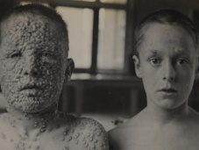

Slide 52
The Clinical Trial Pharmacists serve others through the following core values:
Respect: To recognize the dignity of every person.
Integrity: To be honest, fair and trustworthy
Stewardship: To manage resources responsibly.
Excellence: to work at the highest level of performance, with a commitment to continuous improvement

Slide 53
Enhance the reputation and service-orientation of the Department; though :
duties and responsibilities which include:
coordinating, collaborating and providing expertise in support of clinical investigational drug trials;
performing education responsibilities;
providing accurate and efficient dispensing of medication;
performing administrative responsibilities;

Slide 54
providing direct and/or functional supervision;
maintaining overall responsibility for pharmacy operations in assigned area;
Performing communication responsibilities;
performing cross-functional duties including those of the Oncology/IV Admixture Pharmacist and the Staff Pharmacist, Patient Care;

